Slide 1




INTRODUCTION
What is CRM360?
A Customer Relationship Management platform that gives a business one secure dashboard to manage customers, leads and performance.
The Problem Customer details, leads and sales numbers often live in scattered spreadsheets and chat threads, making it hard for a growing business to track relationships or spot trends. The Solution CRM360 centralizes customer records, lead tracking and revenue analytics into one smart, secure workspace — so a sales team always knows where a deal stands.
Target Users
Sales & business teams tracking leads and deals
CRM administrators managing customers & settings
Managers reviewing revenue & conversion analytics
Customer Management
Lead Tracking
Business Analytics
Secure Workspace
Organize customer information easily
Track leads from new to converted
Monitor growth and performance
Protected, authenticated business environment
CRM360 · Project Overview
2 / 24

Slide 2
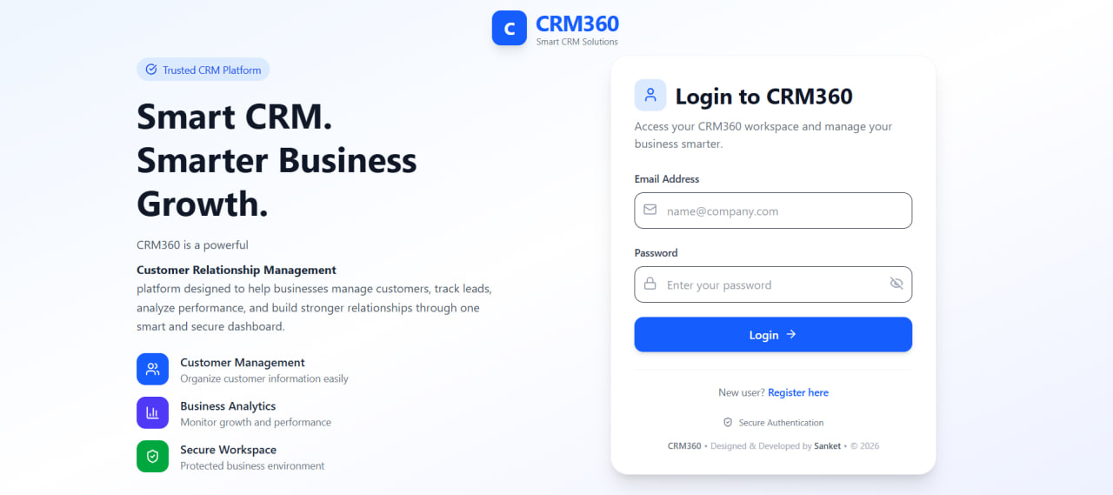
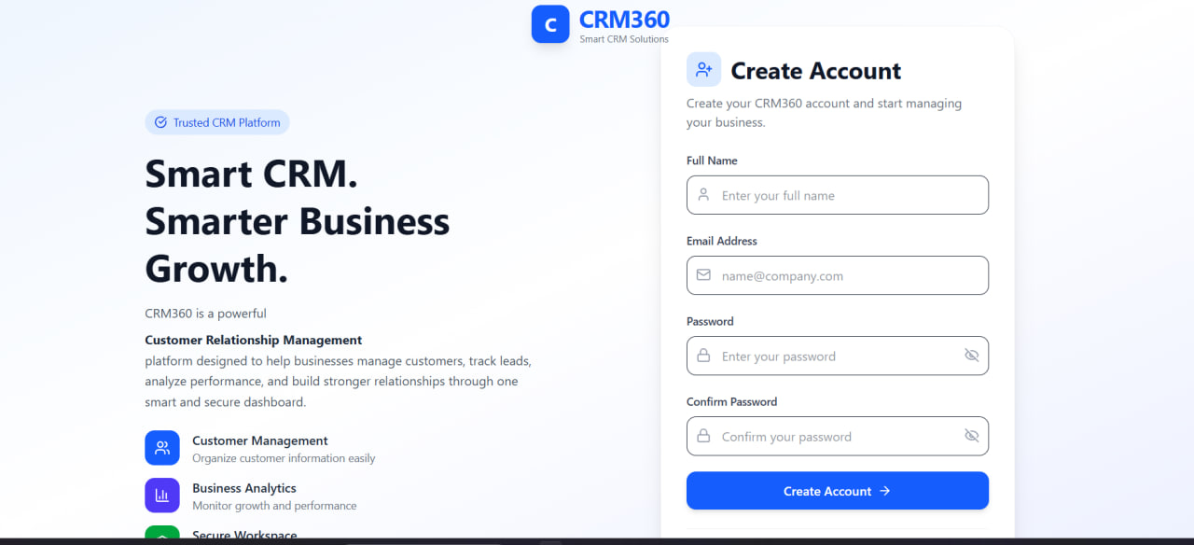
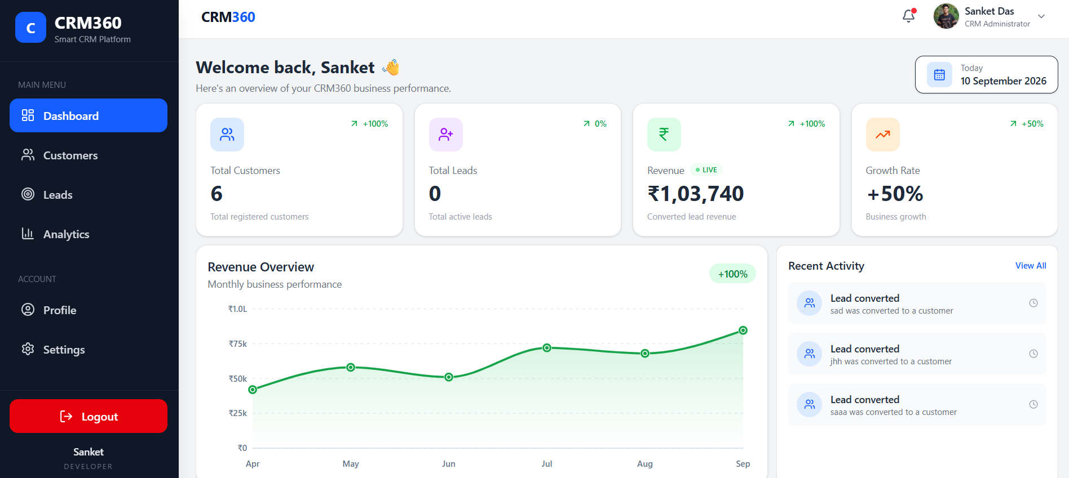
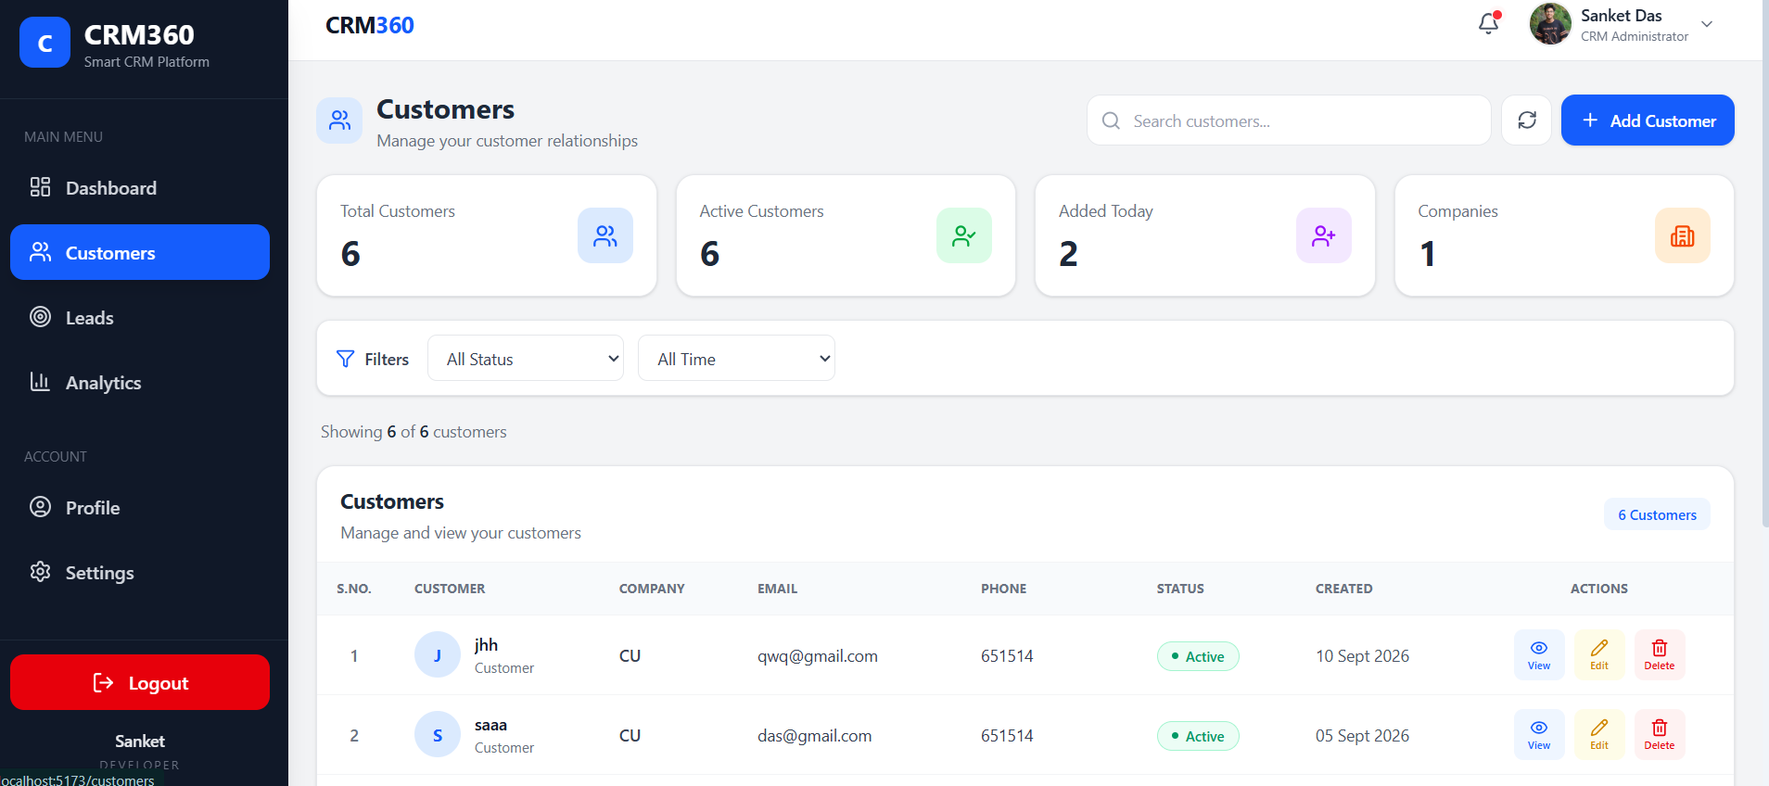
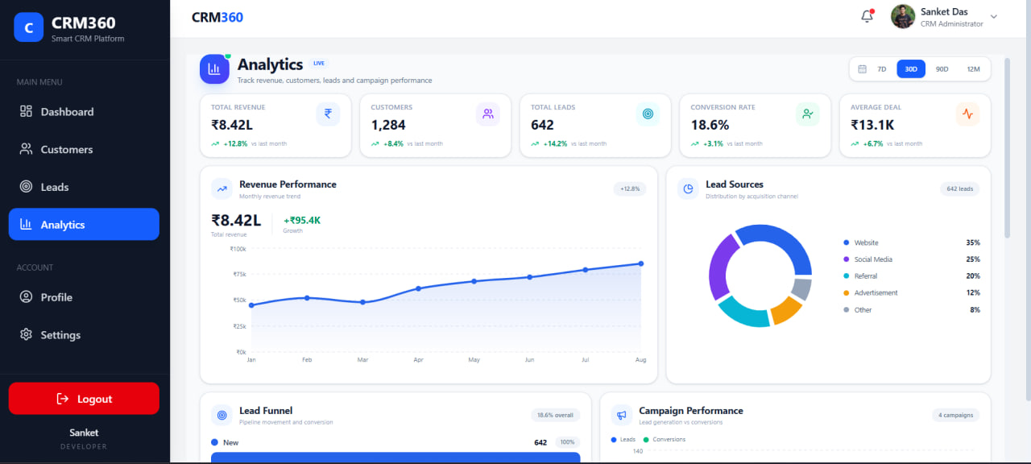
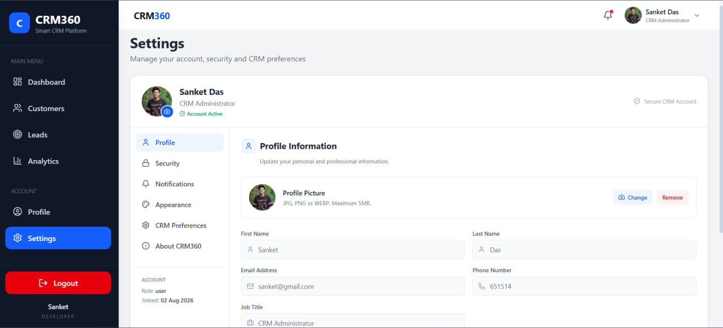
INTERFACE
Website Pages & UI Flow
A quick tour of the core screens — the rest of this deck explains how they work.
Landing
Login / Register
Dashboard
Customers · Leads · Analytics
Settings / Logout
Login
Register
Dashboard
Customers
Analytics
Settings
CRM360 · Project Overview
3 / 24

Slide 3







ARCHITECTURE
Complete System Overview
How a request travels from the browser to the database and back.
User
Frontend
Backend / API
Database
Browser / device
React + Vite UI
Node + Express
MongoDB
Supporting Components
Auth Middleware
REST API Endpoints
File Storage (Multer)
Verifies JWT on protected routes
/api/auth /api/customers /api/leads ...
Handles profile picture uploads
CRM360 · Project Overview
4 / 24

Slide 4
TECHNOLOGY
Technology Stack — Built on the MERN Stack
Frontend
Backend
Database
Auth & Tools
React 19 + Vite
Node.js
MongoDB
JWT tokens
Tailwind CSS
Express 5
Local or Atlas
Role-based access
React Router
Mongoose (ODM)
Auto-created collections
Git / GitHub
Recharts
Multer (uploads)
VS Code · npm
Framer Motion
bcrypt (hashing)
CRM360 · Project Overview
5 / 24

Slide 5


FRONTEND
Frontend Architecture
How the React + Vite client is organized and talks to the backend.
User
UI / Pages
Components
State
API Calls
Backend
Structure & Behaviour
Live UI — Dashboard
Pages map 1:1 to CRM modules — Dashboard, Customers, Leads, Analytics, Settings
Reusable components (forms, cards, tables) live under src/components/
Client-side routing via React Router; services/ wraps API calls
Forms include validation before a request ever leaves the browser
Tailwind CSS handles responsive design across screen sizes
CRM360 · Project Overview
6 / 24

Slide 6
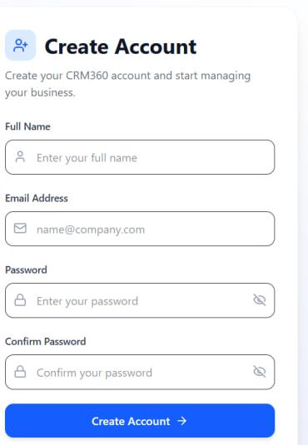


USER FLOW
New User Registration Flow
What the user fills in, mapped to what happens behind the scenes.
On the form
1
Full Name
2
Email Address
3
Password
4
Confirm Password
1
5
Create Account →
2
What happens after Create Account
Frontend validates the fields before submitting
3
Request sent to backend — POST /api/auth
4
Backend checks MongoDB for an existing user
5
Password hashed with bcrypt before it is stored
New user saved — redirected to Login / Dashboard
CRM360 · Project Overview
7 / 24

Slide 7
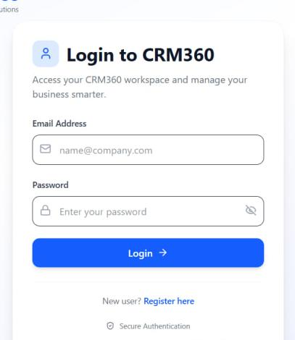

USER FLOW
Login Process
The real Login screen, mapped to what happens behind the scenes.
On the form
1
Email Address
2
Password
3
Login →
4
New user? Register here
1
(4) is a link, not a submit — it takes a new user to the Create Account form on the previous slide.
2
What happens after Login
Frontend validation runs on the form
3
POST login request sent to the backend
4
Database is checked & password verified (bcrypt)
YES → JWT issued, redirect to Dashboard
NO → “Invalid credentials” error
CRM360 · Project Overview
8 / 24

Slide 8

SECURITY
Authentication & Authorization
Authentication
Authorization
“Who is the user?” — the login form checks email & password against the database before any session is created.
“What can the user access?” — once verified, role-based permissions decide which pages and actions are available.
Login
Verify Credentials
Generate JWT Token
Store / Send Token
Access Protected Pages
Protected routes require a valid token — unauthenticated requests are rejected with 401 before reaching a controller.
CRM360 · Project Overview
9 / 24

Slide 9
BACKEND
Backend Architecture
Express + Node request pipeline, from route to response.
Frontend
API Request
Router
Controller
Business Logic
Database
Response
Pipeline Responsibilities
REST API Endpoints
routes/ — maps each API path to a controller
/api/auth
/api/customers
/api/leads
controllers/ — handles the request & response
/api/dashboard
/api/analytics
/api/notifications
middleware/ — verifies JWT before protected routes run
/api/settings
models/ — Mongoose schemas define the data shape
Requests carry a JWT in the Authorization header; middleware verifies the token before the API touches MongoDB.
config/ — database connection & app setup
CRM360 · Project Overview
10 / 24

Slide 10

COMMUNICATION
API / Data Flow
How the frontend and backend exchange data over HTTP.
Frontend
HTTP Request
Backend API
Process Request
Database
JSON Response
Display Result
Common HTTP Methods
GET
POST
PUT / PATCH
DELETE
Retrieve data
Create data
Update data
Delete data
CRM360 · Project Overview
11 / 24

Slide 11

DATABASE
Database Architecture
MongoDB stores each resource as a collection of flexible JSON-like documents.
Backend
DB Connection (Mongoose)
MongoDB
Collections
Users
Customers
Leads
Notifications
Account credentials, profile & role
Name, company, email, phone, status
Status: New → Contacted → Qualified → Converted
Activity events (e.g. lead converted)
Collections are auto-created by Mongoose from the app's schemas; inferred here from the API routes and UI — exact field names follow the actual models/ files.
CRM360 · Project Overview
12 / 24

Slide 12

DATA FLOW
User Data Flow — Example: Adding a Customer
User enters customer details
Frontend form captures the input
Validation runs before submit
API request sent to the backend
Backend processes the request
Record saved in MongoDB
Database & backend send a response
User sees the new customer appear
CRM360 · Project Overview
13 / 24

Slide 13

FEATURES
Important Website Features
Login & Authentication
Live Revenue Dashboard
Customer Management
Lead Tracking & Conversion
Sales & Revenue Analytics
Notifications
Profile & Settings
Light / Dark / System Theme
CRM360 · Project Overview
14 / 24

Slide 14
CODEBASE
Project Folder Structure
Two independent apps — client and server — run as separate processes over the REST API.
CRM360/
├── client/ React + Vite frontend
│ └── src/
│ ├── components/
│ ├── pages/
│ ├── routes/
│ └── services/
├── server/ Node + Express backend
│ ├── config/
│ ├── controllers/
│ ├── middleware/
│ ├── models/
│ ├── routes/
│ └── server.js
├── .gitignore
└── README.md
What Each Folder Does
client/src/components/
Reusable UI building blocks
client/src/pages/
One page per CRM module
client/src/services/
API call wrappers
server/routes/
Maps URLs to controllers
server/controllers/
Request/response handling
server/models/
Mongoose schemas
server/middleware/
JWT auth checks
server/config/
Database connection setup
CRM360 · Project Overview
15 / 24

Slide 15

CONFIGURATION
Environment Variables
The server's runtime configuration — expected values based on the stack (port, database, JWT secret).
.env (server/)
Never Commit Secrets
PORT = 5000
Never share passwords, API keys, database credentials, or JWT secrets publicly. The .env file stays out of Git via .gitignore.
MONGO_URI = <your_mongodb_connection_string>
JWT_SECRET = <your_jwt_secret>
These values reflect the stack's known configuration (Node/Express on port 5000 with MongoDB + JWT); confirm the exact keys against the project's own .env before presenting.
CRM360 · Project Overview
16 / 24

Slide 16



SETUP
How to Install the Project
1
Install prerequisites
Node.js, npm, MongoDB, Git and VS Code
2
Clone the repository
github.com/beesank8/CRM360--SaaS-Customer-Relationship-Management
3
Open in VS Code
File → Open Folder → select the CRM360 folder
4
Install & start the server
Terminal 1: cd server → npm install → npm start (port 5000)
5
Install & start the client
Terminal 2: cd client → npm install → npm run dev (port 5173)
CRM360 · Project Overview
17 / 24

Slide 17
SETUP
How to Run the Project
Open Terminal
Go to Project Folder
Install Dependencies
Start MongoDB
Start Backend Server
Start Frontend
Open Localhost URL
Website Running Successfully
Frontend
Backend
http://localhost:5173
http://localhost:5000
Make sure MongoDB is running locally (or your Atlas connection is reachable) before starting the backend.
CRM360 · Project Overview
18 / 24

Slide 18

MAIN DIAGRAM
Complete Application Flow
User
Browser
Frontend UI
Login / Register
API Request (JWT)
Backend Server
Auth & Business Logic
Database
JSON Response
Updated UI
User sees the result and continues browsing
React + Vite renders the interface the user interacts with.
Every protected request carries a JWT the backend middleware verifies.
Express controllers run the business logic and talk to MongoDB.
MongoDB stores and returns the data as JSON, sent back to the UI.
CRM360 · Project Overview
19 / 24

Slide 19
SECURITY
Error Handling & Security
Password Hashing
JWT Authentication
Role-Based Access
Passwords hashed with bcrypt before storage — plaintext is never saved
Signed tokens issued on login; verified on every protected request
Permissions scale by role so users only reach what they're allowed to
Protected API Routes
Environment Variables
Input Validation
Auth middleware checks the token before any controller runs
Secrets (DB URI, JWT secret) kept out of source control via .env
Forms validate data on the frontend before it reaches the API
CRM360 · Project Overview
20 / 24

Slide 20

QUALITY
Testing Checklist
What to verify before — or during — a live demo.
Frontend
Backend / API
Database
Login Testing
Pages render correctly, navigation works across all modules
Each endpoint returns the expected response and status code
Records persist correctly after create / update / delete
Correct credentials succeed; wrong ones show a clear error
Registration Testing
Form Validation
Error Handling
Responsive / Mobile
New accounts are created and duplicate emails are rejected
Required fields, email format and password rules are enforced
Network/server failures show a friendly message, not a crash
Layout adapts cleanly across desktop and smaller screens
CRM360 · Project Overview
21 / 24

Slide 21

LIVE DEMO
Demo Flow
A suggested sequence for presenting CRM360 live.
1
Open the website
2
Register a new user
3
Login
4
Open the Dashboard
5
Demonstrate a main feature (Leads / Customers)
6
Show the Analytics / API result
7
Logout
CRM360 · Project Overview
22 / 24

Slide 22
TROUBLESHOOTING
Common Problems & Solutions
Problem
Possible Solution
npm install error
Check your Node.js / npm version matches the project's requirement
MongoDB connection failed
Check the database URI / credentials and that MongoDB is running
Port already in use (5000 / 5173)
Stop the conflicting process or change the port in .env
API not responding
Confirm the backend server (npm start) is actually running
Login not working
Check the database connection and the JWT_SECRET configuration
CORS error
Verify the backend's CORS configuration allows the client's origin
Environment variable missing
Check .env exists in server/ with all required keys set
CRM360 · Project Overview
23 / 24

Slide 23

CONCLUSION
Bringing It All Together
Frontend
Backend
Database
User Interface
Business Logic & APIs
Data Storage
Authentication
API
Deployment
User Security
Frontend ↔ Backend Communication
Making the Website Available Online
Thank You
24 / 24

